Slide 1
PROBLEM SOLVING AND PYTHON PROGRAMMING
UNIT 1

Slide 2
Unit - 1
COMPUTATIONAL THINKING AND PROBLEM SOLVING
Fundamentals of Computing – Identification of Computational Problems -Algorithms, building blocks of algorithms (statements, state, control flow, functions), notation (pseudo code, flow chart, programming language), algorithmic problem solving, simple strategies for developing algorithms (iteration, recursion). Illustrative problems: find minimum in a list, insert a card in a list of sorted cards, guess an integer number in a range, Towers of Hanoi.

Slide 3
FUNDAMENTALS OF COMPUTING
Computers are seen everywhere around us, in all spheres of life, in the field of education, research, travel and tourism, weather forecasting, social networking, e-commerce etc. Computers have now become an essential part of our lives. Today, no organization can function without a computer. In fact, various organizations have become paperless. Computers have evolved over the years from a simple calculating device to high-speed portable computers.
A computer is an electronic device that can be programmed to accept data (input), process it and generate result (output). A computer along with additional hardware and software together is called a computer system.
Computers are very versatile as they do a lot of different tasks such as storing data, weather forecasting, booking airlines, railway or movie tickets and even playing games.

Slide 4
Data: Data is defined as an un-processed collection of raw facts, suitable for communication, interpretation or processing.
Information: Information is a collection of facts that is processed to give meaningful, ordered or structured information.

Slide 5
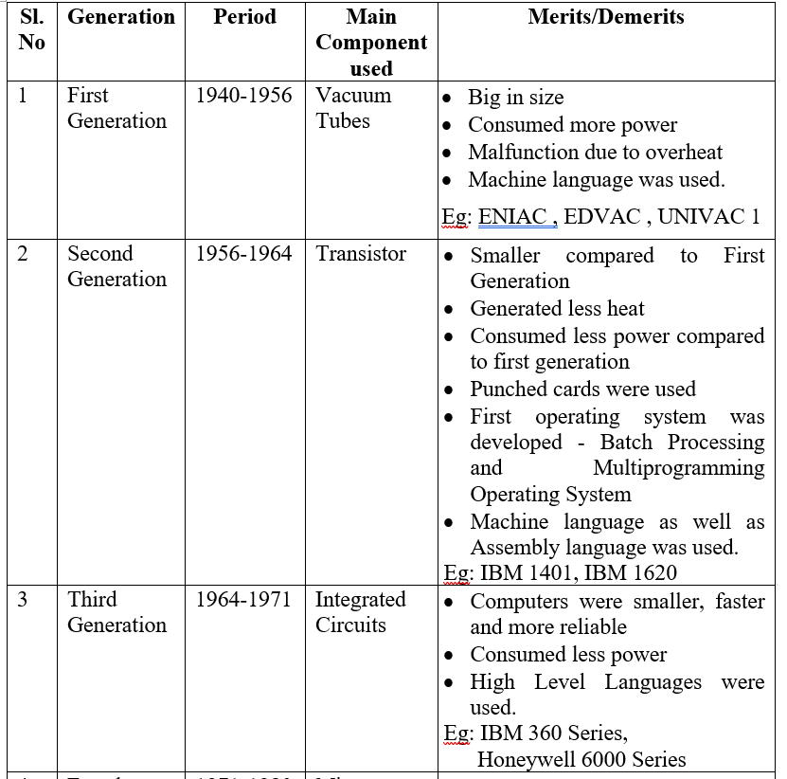
Generations of a Computer
Growth in the computer industry is determined by the development in technology. Based on various stages of development, computers can be categorized into different generations.

Slide 6
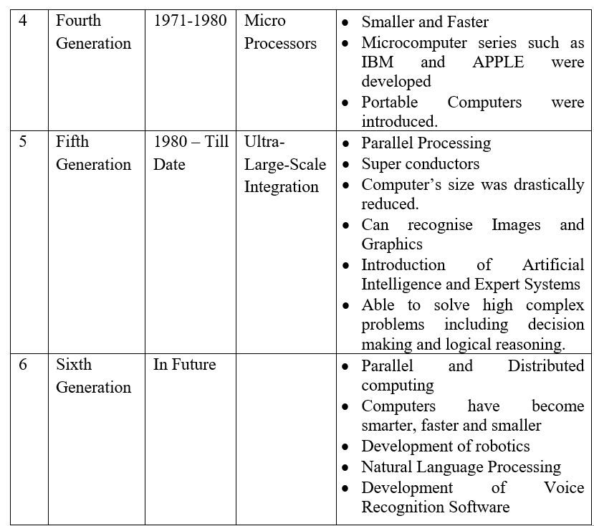

Slide 7
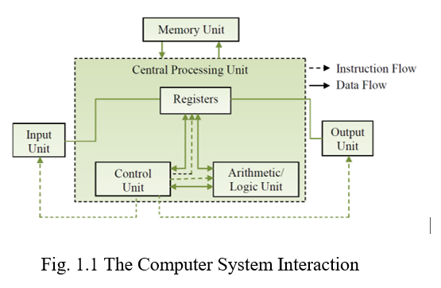
Components of a Computer
The computer is the combination of hardware and software. Hardware is the physical component of a computer like motherboard, memory devices, monitor, keyboard etc., while software is the set of programs or instructions. Both hardware and software together make the computer system to function.
The computer system hardware comprises of three main components:
1. Input / Output (I/O) Unit,
2. Central Processing Unit (CPU), and
3. Memory Unit

Slide 8
Input / Output Unit
The input/output unit consists of the Input unit and the Output unit.
The user interacts with the computer via the I/O unit.
The Input unit
- It accepts data from the user.
It converts the data into a form that is understandable by the computer.
The input is provided to the computer using devices like keyboard,
trackball and mouse.
The Output unit
- provides the processed data (i.e.) the information to the user.
provides output in a form that is understandable by the user.
Some of the output devices are monitor and printer.

Slide 9
Central Processing Unit: (CPU)
CPU or the processor is often called the Brain of computer.
CPU controls, coordinates and supervises the operations of the computer.
CPU consists of
i. Arithmetic Logic Unit (ALU)
ii. Control Unit (CU) and
iii. Set of Registers.

Slide 10
Arithmetic Logic Unit
ALU consists of two units. They are arithmetic unit and logic unit.
The Arithmetic unit performs arithmetic operations on the data that is made available to it. Example: addition, subtraction, multiplication and division.
The Logic unit performs logic operations. Example: comparison of numbers, letters and special characters. Testing for greater than, less than or equal to condition.
ALU performs arithmetic and logic operations, and uses registers to hold the data that is being processed.

Slide 11
Registers
Registers are high-speed storage areas within the CPU, but have the least storage capacity.
Registers are not referenced by their address, but are directly accessed and manipulated by the CPU during instruction execution.
Registers store data, instructions, addresses and intermediate results of processing. So, registers are often called as CPU’s working memory.
The data and instructions that require processing must be brought in the registers of CPU before they can be processed.
For example, if two numbers are to be added, both numbers are brought in the registers, added and the result is again placed in the register.

Slide 12
Some of the important registers in CPU are as follows.
(i) ACC: Accumulator stores the result of arithmetic and logic operations.
(ii) IR: Instruction Register contains the current instruction most recently fetched.
(iii)PC: Program Counter contains the address of next instruction to be processed.
(iv)MAR: Memory Address Register contains the address of next location the in memory to be accessed.
(v) MBR: Memory Buffer Register temporarily stores data from memory or the data to be sent to memory.
(vi)DR: Data Register stores the operands and any other data.
The size of register, also called Word Size, indicates the amount of data. The size of a register may be 8, 16, 32 or 64 bits.

Slide 13
Control Unit: (CU)
The control unit organizes the processing of data and instructions.
The CU acts as a supervisor, controls and coordinates the activity of the other units of computer.
CU coordinates the input and output devices of a computer.
It directs the computer to carry out stored program instructions in the IR.
It instructs the ALU to perform the arithmetic or logic operations.
When a program is run, the PC keeps track of the instruction to be executed next.
CU tells ‘when to fetch the data and instructions’, ‘what to do’, ‘where to store the result’ etc.
CU also holds the CPU’s Instruction Set, which is a list of all operations that the CPU can perform.

Slide 14
Memory Unit
The memory unit consists of cache memory, primary memory and secondary memory.
Memory unit stores the data and instructions, intermediate results and output temporarily during processing of data.
This memory is called main memory / primary memory. Example: RAM, ROM.

Slide 15
Cache Memory
The data and instructions that are required during the processing of data are brought from the secondary storage devices and stored in the RAM.
Next for processing they are taken from RAM to registers.
The time taken to move the data between RAM and CPU registers is large. This affects the speed of processing of computer and results in decreasing the performance of CPU.
Cache memory (high speed memory) is placed in between RAM and CPU.
Cache memory is a storage buffer that stores the data that is used more often. So, during processing, CPU first checks cache memory for required data. If data is not found in cache, then it looks in RAM for that data.
To access the cache memory, CPU does not have to use the mother board’s system bus for data transfer.
Cache is twice as fast as RAM.
The CPU has a built-in Level 1 (L1) cache and Level 2 (L2) cache, as shown in below.

Slide 16
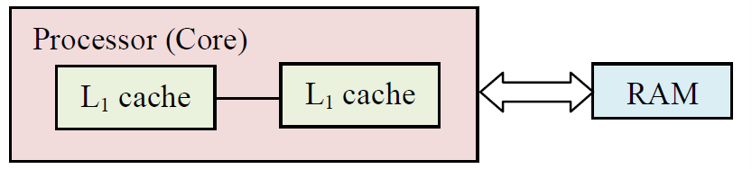

Slide 17
Primary Memory
Primary memory is the main memory of computer. It is used to store data and
instructions during the processing.
It is semiconductor memory.
Primary memory is of two kinds (i) Random Access Memory (RAM) (ii) Read Only Memory (ROM).

Slide 18
RAM
RAM is volatile.
It stores data when the computer is on.
Information in RAM gets erased when the computer is turned off.
RAM provides temporary storage for data and instructions.
It provides a limited storage capacity, due its high cost.

Slide 19
ROM
ROM is non-volatile memory and is a read only memory.
Storage in ROM is permanent in nature.
Information will not be erased even if the computer is turned off.
ROM comes programmed by the manufacturer.

Slide 20
Secondary Memory
The secondary memory stores data and instructions permanently. The information can be stored in secondary memory for a long time (years), and is generally permanent in nature unless erased by the user.
Non-volatile memory.
It provides back-up storage for data and instructions. Hard disk drive, floppy drive and optical disk drives are some examples of secondary storage devices.
The data and instructions that are currently not being processed, but may be required later by CPU are stored in secondary memory.
Secondary memory has a high storage capacity than the primary memory.
Secondary memory is also cheaper than the primary memory.
But it takes longer time to access the data and instructions stored in secondary memory than in primary memory.

Slide 21
IDENTIFICATION OF COMPUTATIONAL PROBLEMS
Identification of computational problem is part of the scientific method, as it serves as the first step in a systematic process to identify, evaluate a problem and explore potential solutions.
Computational problem identification consists of two steps:
Identifying and acknowledging that there is a problem
Developing a problem identification statement.
Computational problem Identification, require a certain mode of approach or way of thinking. This approach is often called computational thinking and is similar to the scientific method with predictions.
Understanding computational thinking will give a foundation for solving problems. Computational thinking is part of a problem-solving process that ends with writing a program.
In order to make predictions using computational thinking, we need to define four steps related to the identification of problem and its solution: They are, decomposition, pattern recognition, abstraction, and algorithm design.

Slide 22
Decomposition
The first step of computational thinking is decomposition. This stage starts by analyzing the problem, stating it precisely, and establishing the criteria for the solution.
A computational thinking approach to a solution often starts by breaking the problem down into smaller more familiar components so they can be managed easier. The more you can break a problem down, the easier it is to solve.
This stage also allows to develop a better understanding of the problem by identifying all the components in detail.

Slide 23
Pattern Recognition
The second step is pattern recognition whereby similarities and trends are identified within the problem.
If some problems are similar in nature, there is a good chance that they can be solved using similar, or repeated techniques.
This is a key component for making efficient solutions, and saving time in the long run. Pattern recognition is a key skill to create efficient and effective solutions to given problems.

Slide 24
Abstraction
The abstraction stage involves the identification of key components of the solution.
Rather than looking at specific details, it requires the ability to filter out unnecessary elements of a problem so that only focus on the important elements.
Abstraction allows to consider all the key components prior to the creation of the final solution, while ignoring any unnecessary details.

Slide 25
Algorithm Design
The final stage within the computational thinking process is algorithm design whereby a detailed step-by-step set of instructions are created which explain how to solve the problem.
The measure of a good algorithm is one that can be passed to someone else to follow without the need for any extra explanation.
This process uses inductive thinking and is needed for transferring a particular problem to a larger class of similar problems. This step is also sometimes called algorithmic thinking.

Slide 26

NEED FOR LOGICAL ANALYSIS AND THINKING
Computer can perform variety of tasks like receiving data, processing it and producing useful results. It cannot perform on its own. A computer needs to be instructed to perform a task.
The computer works on set of instructions, called computer program to carry out a particular task, so that the computer can process that task.

Slide 27
To produce an effective execution of the computer program, it is very important that the programmer must take care of each and every step or instruction in a proper sequence.
To design a program, a programmer must determine three basic steps.
1. The instructions to be performed.
2. The sequence in which these instructions are to be performed.
3. The data required to perform these instructions.
For example, to calculate the sum of two numbers, read the value of two numbers A and B, add A and B and store the sum value in C.

Slide 28
To solve the problem using computer, the following steps should be followed.
Problem must be analysed thoroughly.
Solution method is broken down into a sequence of small tasks.
Based on the analysis, an algorithm must be prepared to solve the problem.
The algorithm is expressed in a precise notation. This notation is known as a computer program.
The computer program is then fed into the computer.
The instruction in the program is executed one after the other and finally outputs the expected result.

Slide 29
ALGORITHMS
Algorithm is an ordered sequence of finite, well defined, unambiguous instructions for completing a task.
It is a step-by-step procedure for solving any problem.
Algorithm is an English-like representation of the logic which is used to solve the problem.
To accomplish a particular task, different algorithms can be written. They differ by their time and space.
The programmer selects the best suited algorithm for the given task to be solved.
The algorithm can be implemented in many different languages by using different methods and programs.
The algorithm is independent of any programming language.

Slide 30
Guidelines for writing Algorithms
An algorithm should be clear, precise and well defined.
It should always begin with the word ‘Start’ and end with the word ‘Stop’.
Each step should be written in a separate line.
Steps should be numbered as Step 1, Step 2, and so on.

Slide 31
Example: Algorithms to find the greatest among three numbers
Step 1: Start.
Step 2: Read the three numbers A, B, C.
Step 3: Compare A and B. If A is the greatest perform step 4 else perform step 5.
Step 4: Compare A and C. If A is the greatest, output “A is the greatest” else output “C is the greatest”.
Step 5: Compare B and C. If B is the greatest, output “B is the greatest” else output “C is the greatest”.
Step 6: Stop.

Slide 32
Properties of an Algorithm
Finiteness: An algorithm must be terminated after a finite number of steps.
Definiteness: Each step of an algorithm must be precisely defined.
Input: The data must be present before any operations can be performed on it. The initial data is supplied by a READ instruction. A variable can be given initial value using the SET instruction.
Example: READ A, B
SET N=0
Output: After executing all the steps of the algorithm at least one output must be obtained. The WRITE statement is used to print messages and variables.
Effectiveness: The operations to be performed in the algorithm can be carried out manually in finite intervals of time.

Slide 33
Advantages of Algorithm
It is a simple to understand step by step solution of the problem.
It is easy to debug.
It is independent of programming languages.
It is compatible to computers, because each step of an algorithm can be easily coded into its equivalent high level language.

Slide 34
BUILDING BLOCKS OF ALGORITHMS
The building blocks are,
Statements
State
Control flow and
Functions

Slide 35
Statements / Instructions
The algorithm consists of finite number of statements.
The statements must be in an ordered form.
The time taken to execute all the statements of the algorithm should be finite and within a reasonable limit.

Slide 36
State
The algorithm must have an instruction for a program to do.
The state of the instruction will be changed during execution.
The state or condition of the instruction determines the logic flow of the program or program termination.
During execution of the instruction the state will be stored in the data structure.

Slide 37
Control flow
The logic of a program may not always be executed in a particular order. The execution of statements is based on a decision.
The basic control flows needed for writing good and efficient algorithms are,
Sequence Control Flow
Selection Control Flow
Iteration (Looping) Control Flow
These control flows allow the program to make choices, change direction or repeat actions.

Slide 38
Sequence Control Flow
In sequence control flow, the instructions are executed in a linear order one after the other. The instructions in sequence control flow are executed exactly once.
Example: Algorithm to find the sum of two numbers.
Step 1: Start
Step 2: Read two numbers A and B
Step 3: Calculate sum = A + B
Step 4: Print the sum value
Step 5: Stop.
This algorithm performs the steps in a purely sequential order.

Slide 39
Selection Control Flow
In a selection control flow, the step to be executed next is based on a decision taken. If the condition is true, one path is followed. If the condition is false, another path is followed.
Example: Algorithm to find the greatest among three numbers.
Step 1: Start.
Step 2: Read the three numbers A, B, C.
Step 3: Compare A and B. If A is the greatest perform step 4 else perform step 5.
Step 4: Compare A and C. If A is the greatest, print “A is the greatest” else print “C is the greatest”.
Step 5: Compare B and C. If B is the greatest, print “B is the greatest” else print “C is the greatest”.
Step 6: Stop.

Slide 40
Iteration (Looping) Control Flow
In iterative control flow, one or more instructions are executed repeatedly. In this control flow a condition is checked. Based on the result of this conditional check (true or false) the control goes back to one of the already executed steps to make a loop.
Example: Algorithm to find the sum of first 100 integers.
1. Start
2. Assign sum = 0, i = 0.
3. Calculate i = i + 1 and sum = sum + i
4. Check whether i>= 100, if no repeat step 3. Otherwise go to next step.
5. Print the value of sum
6. Stop

Slide 41
Functions
Any complex problem will become simpler if the problem is broken smaller and the smaller problems are solved. The functions are solutions to smaller problems. These can be used to solve bigger, complex problems.
During algorithm design the complex problems are divided into smaller and simpler tasks. These tasks are solved independently by functions.
A function is a block of organized, reusable code that is used to perform a similar task of some kind.
It avoids the repetition of some codes over and over. It means the programmer need not have to write same instructions for a number of times, to perform the same action.
Functions help easy debugging, testing and understanding of the program.
Functions reduce program size and the program development time.
Functions provide better modularity and high degree of reusability for the problems.

Slide 42
NOTATIONS
A notation is a system of characters, expressions, graphics or symbols used in problem solving process to represent technical facts to facilitate the best result for a problem.
Example: Pseudocode, Flowchart.

Slide 43
Pseudocode
Pseudocode is a short, readable and formally styled English language used for explaining an algorithm.
Pseudocode does not include details like variable declarations, subroutines etc. It is a short hand way of describing a computer program.
Using Pseudocode, it is easier for a programmer or a non-programmer to understand the general working of the program, because it is not based on any programming language.
It is used to give a sketch of the structure of the program, before the actual coding. It is not machine readable.
Pseudocode cannot be complied or executed. There is no standard for the syntax of Pseudocode.

Slide 44
Preparing a Pseudocode
Pseudocode is written using structured English.
The programmers may use their own style for writing the Pseudocode, which can be easily understood. It never use the syntax of any programming language.
Pseudocode uses some keywords to denote programming process. Some of them are as follows.
Input : INPUT, GET, READ and PROMPT
Output : OUTPUT, PRINT, DISPLAY and SHOW
Processing : COMPUTE, CALCULATE, DETERMINE, ADD, SUBTRACT, MULTIPLY and DIVIDE
Initialize : SET and INITIALISE
Incrementing : INCREMENT

Slide 45
The Keywords should be capitalized.
There are three control structures used in Pseudocode.
They are,
a. Sequence control structure
b. Selection control structure and
c. Iteration control structure

Slide 46
Sequence Control Structures
In sequence control structure, the steps are executed in a linear order one after the other. They are executed in the order in which they are written, from top to bottom.
EXAMPLE: Find product of any two numbers
READ values of A and B
COMPUTE C by multiplying A with B
PRINT the result C
STOP

Slide 47
Selection Control Structure
In a selection control structure, the step to be executed next is based on a decision taken. If the condition is true, some path is followed. If the condition is false, different path is followed.
There are two main selection structures: They are,
1. IF-THEN-ELSE statement
2. CASE statement

Slide 48
The IF-THEN-ELSE statement
In IF-THEN-ELSE selection structure, if the condition is true, the THEN part is executed. Otherwise the ELSE part is executed.
IF condition THEN
Process 1
ELSE
Process 2
END IF
EXAMPLE: Find maximum of any three numbers
READ values of A, B, C
IF A is greater than B THEN
ASSIGN A to MAX
ELSE
ASSIGN B to MAX
IF MAX is greater than C THEN
PRINT MAX is greatest
ELSE
PRINT C is greatest
STOP

Slide 49
The case statement
The case statement is used when many number of conditions to be checked. In a case statement, depending on the expression, one of the conditions is true. Based on the value, the corresponding statements are executed. If no match for the expression occurs, then the default option is executed.
CASE value1:
Process1
CASE value2:
Process2
CASE value n:
Process n
END CASE

Slide 50
Iterative Control Structures
In iterative control structure, a condition is checked. Based on the result of this conditional check (true or false) different paths are followed, where the control goes back to one of the already executed steps to make a loop.
There are two iterative control structures. They are, WHILE and DO-WHILE.
In WHILE loop, the condition is executed at the beginning of the loop. If the condition is false then the loop will not be executed.
WHILE condition
Statements
END WHILE
DO
Statements
WHILE condition
END DO

Slide 51
EXAMPLE: Find sum of first 100 integers
INITIALIZE sum to zero
INITIALIZE i to zero
DO WHILE (i less than 100)
INCREMENT i by 1
ADD i to SUM and store in SUM
END DO
PRINT SUM
STOP

Slide 52
Advantages of Pseudocode
A Pseudocode is closer to the programming code. Thus it can be easily converted into the actual program.
Writing Pseudocode is much easier in comparison with drawing a flowchart.
Limitations of Pseudocode
It is difficult to understand and manipulate Pseudocode as compared to algorithm and flowchart.
As there are no specific standards for writing Pseudocode, it becomes hard to maintain consistency.

Slide 53
Flowchart
A flowchart is a diagrammatic representation of the logic for solving a task.
A flowchart is drawn using boxes of different shapes with lines connecting them to show the flow of control.
The purpose of drawing a flowchart is to make the logic of the program clearer in a visual form.
The logic of the program is communicated in a much better way using a flowchart. Since flowchart is a diagrammatic representation, it forms a common medium of communication.

Slide 54
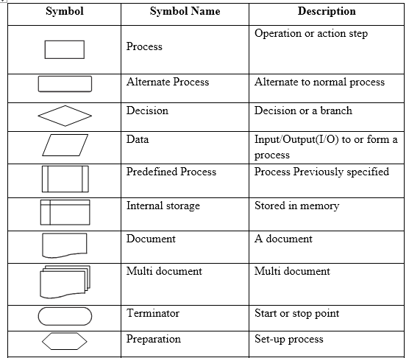
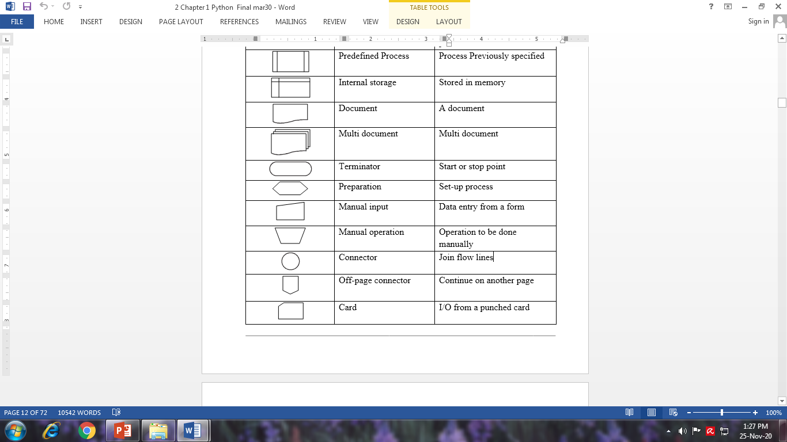
Flowchart Symbols

Slide 55
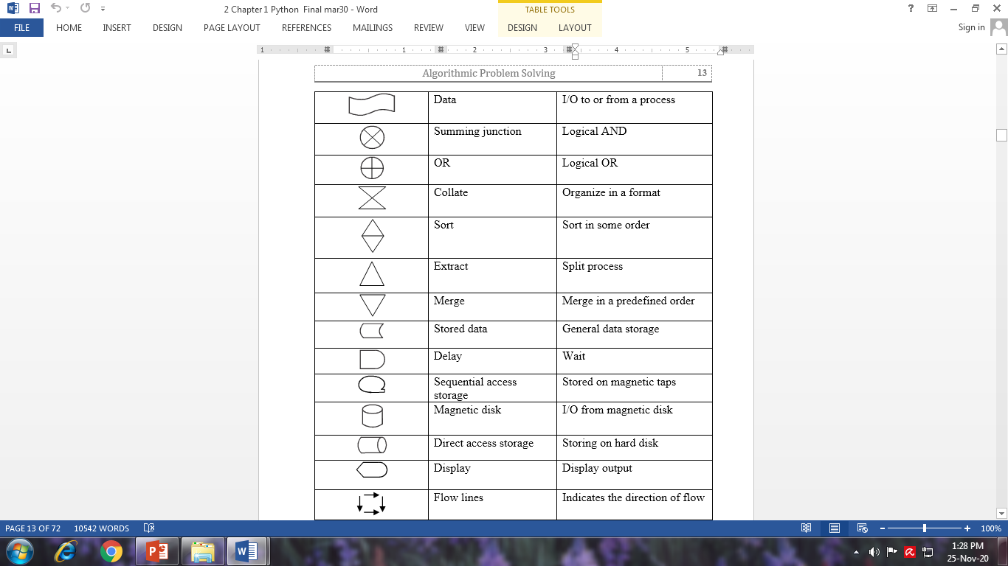

Slide 56
Guidelines for preparing a flowchart
Certain rules that must be followed while drawing a flowchart are given below.
There can be only one start and one stop symbol in a flowchart.
Only one flow line can be used with the start and stop symbol.
Direction of flow of information in a flowchart must be from top to bottom or from left to right. Relevant symbols must be used while drawing a flowchart.
Only one flow line should come out from a process symbol.

Slide 57
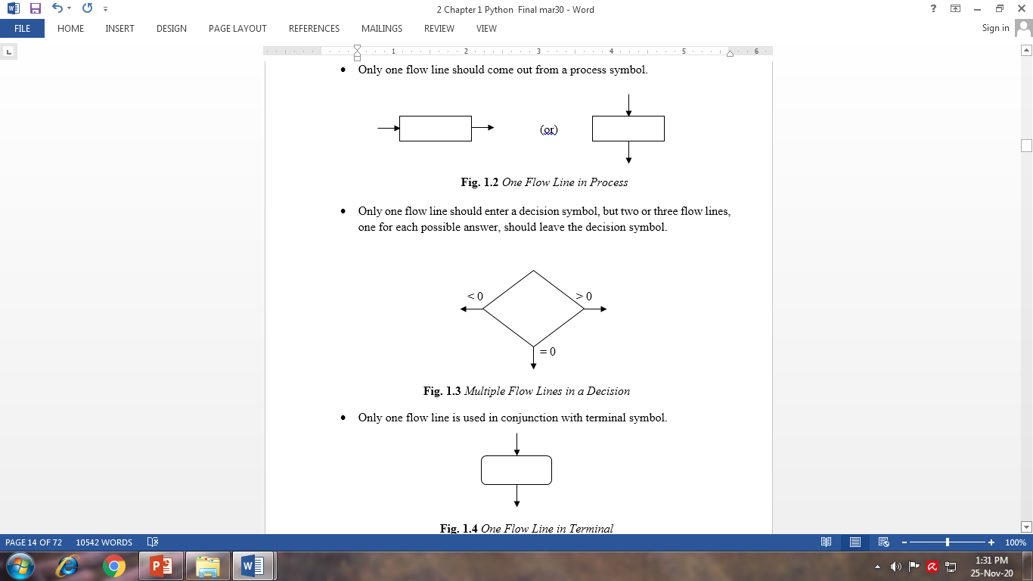

Slide 58
If the flowchart becomes complex, it is better to use connector symbols to reduce the number of flow lines.
The flow lines should not cross each other.
Ensure that the flowchart has a logical start and finish.
It is useful to test the validity of the flowchart by passing through it with a simple test data.

Slide 59
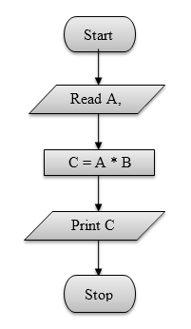
Sequence Control Structure
In sequence control structure, the steps are executed in linear order one after the other.

Slide 60
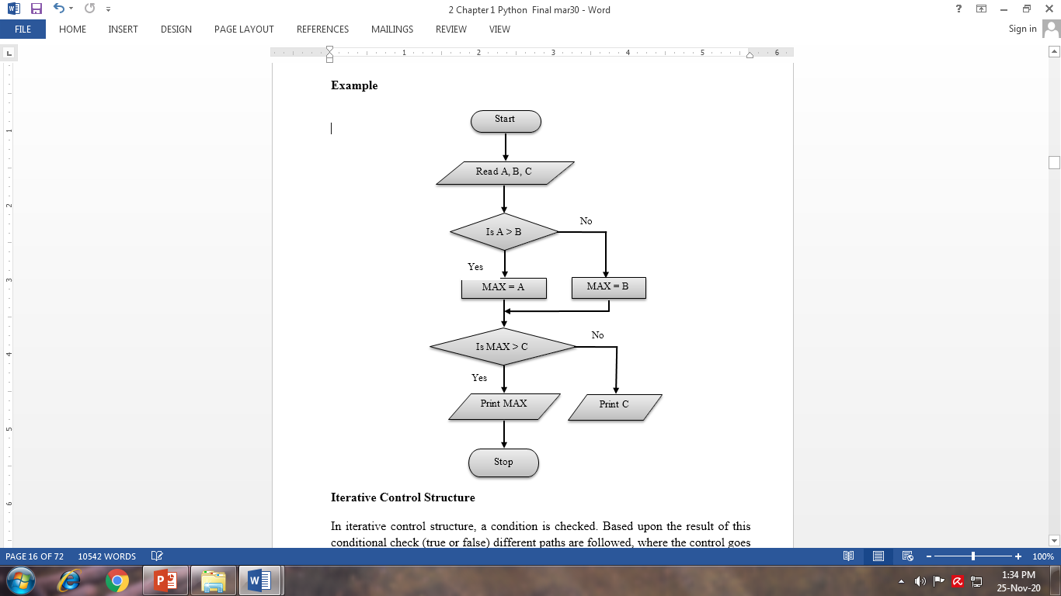
Selection Control Structure
In a selection control structure, the step to be executed next is based on a decision taken. If the condition is true, one path is followed. If the condition is evaluated to false, another path is followed.

Slide 61
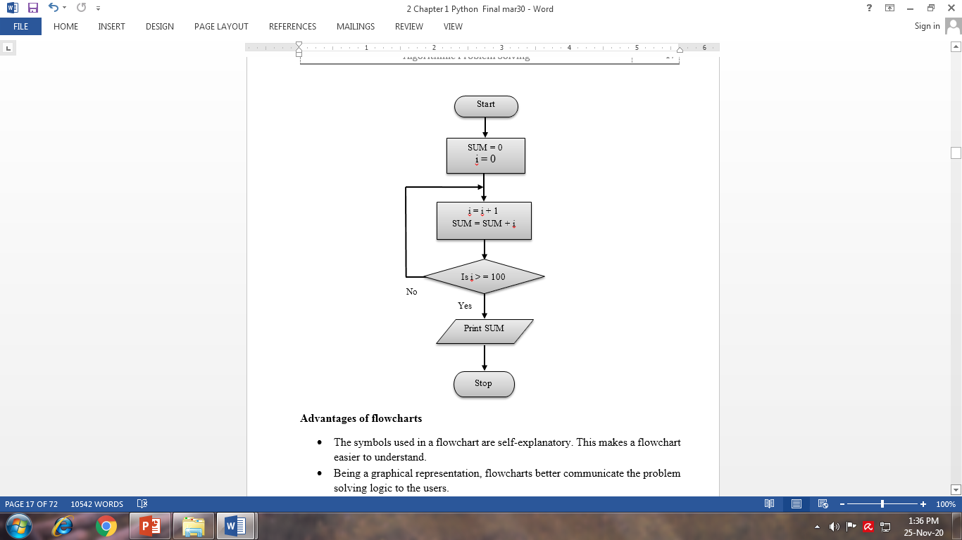
Iterative Control Structure
In iterative control structure, a condition is checked. Based upon the result of this conditional check (true or false) different paths are followed, where the control goes back to one of the already executed steps to make a loop.

Slide 62
Advantages of flowcharts
The symbols used in a flowchart are self-explanatory. This makes a flowchart easier to understand.
Being a graphical representation, flowcharts better communicate the problem solving logic to the users.
With the help of a flowchart, a problem can be analysed in an effective way.
It also helps in monitoring, data collection and identifies areas for improvement or increase in efficiency.

Slide 63
Limitations of flowchart
In case of large programs, the flowcharts may continue too many pages. This makes them difficult to understand.
It takes a lot of time to represent a program diagrammatically.
Any changes or modification in a flowchart usually requires redrawing the entire flowchart. It is a challenging job.

Slide 64
Programming Language
A programming language is a simplified form of English (with math symbols) that adheres to a strict set of grammatical rules.
Programming languages, limit the vocabulary and grammar to become much simpler. Although a programming language is simple in form, it is not always easy to use.
Programming languages forces the user to write very simple, exact instructions.
Coding
Translating an algorithm into a programming language is called coding the algorithm.
The product of the translation or the coding for all the algorithms in the problem are tested by collecting them into programs and executing them on computers.
If the program fails to produce the desired results, the programmer must debug it and determine what is wrong and then modify the program.

Slide 65
Implementation
The combination of coding and testing algorithms is called implementation.
Code is the product of translating an algorithm into a programming language. The term code may refer to a complete program or to any portion of a program.

Slide 66
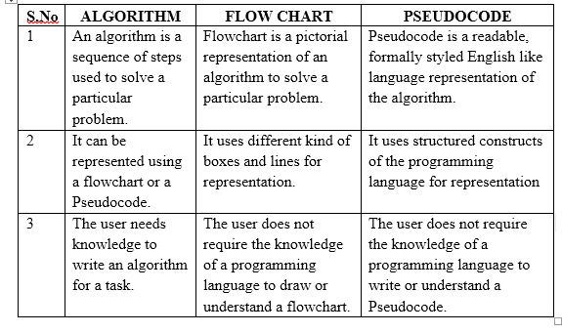
Difference between Algorithm, Flowchart, and Pseudocode

Slide 67
ALGORITHMIC PROBLEM SOLVING
Every problem’s solution starts with a plan and that plan is called an algorithm. So, an algorithm is a plan for solving a problem.
There are many ways to write an algorithm. Some are very informal, some are quite formal and mathematical in nature, and some are quite graphical.
The development of an algorithm is the key step in algorithmic problem solving. Once an algorithm is developed, it can be translated into a computer program in some programming language.

Slide 68
The algorithmic problem solving process consists of five major steps.
Step 1: Obtain a description of the problem.
Step 2: Analyze the problem.
Step 3: Develop a high-level algorithm.
Step 4: Refine the algorithm by adding more details.
Step 5: Review the algorithm.

Slide 69
Step 1: Obtain a description of the problem
The algorithmic problem solving process starts by obtaining a description of the problem. This step is much more difficult than it appears. In the software development process, the word ‘client’ refers to a person who wants to find a solution to a problem, and the word ‘developer’ refers to a person who finds a way to solve the problem. The developer must create an algorithm that will solve the client's problem.
The client is responsible for creating a description of the problem, but this is often the weakest part of the process. A problem description suffers from one or more of the following types of defects:
the description may rely on unstated assumptions
the description may be ambiguous
the description maybe incomplete
the description may have internal contradictions
These defects are due to carelessness by the client. Part of the developer’s responsibility is to identify, the defects in the description of a problem, and to work with the client to rectify those defects.

Slide 70
Step 2: Analyze the problem
The purpose of this step is to determine both the starting and the ending points for solving the problem.
This process is analogous to a mathematician determining what is given, and what must be proven. A good problem description makes it easier to perform this step.
Asking the following questions often helps to determine the starting point.
What data are available?
Where is that data from?
What are the rules exist for working with the data?
What are the relationships exist among the data values?

Slide 71
When determining the ending point, algorithm need to describe the characteristics of a solution. Asking the following questions often helps to determine the ending point.
What new facts will we have?
What items would have changed?
What changes would have been made to those items?
What things will no longer exist?

Slide 72
Step 3: Develop a high-level algorithm
An algorithm is a plan for solving a problem, but plans come in several levels of detail.
It is better to start with a high-level algorithm that includes the major part of a solution, but leaves the details until later.

Slide 73
Step 4: Refine the algorithm by adding more detail
A high-level algorithm shows the major steps that need to be followed to solve a problem. Our goal is to develop algorithms that will lead to computer programs.
Consider the capabilities of the computer and provide enough details so that someone else could use the algorithm to write the computer program.
For larger, more complex problems, it is common to go through this process several times. Each time, more details are added to the previous algorithm, for further refinement.
This technique of gradually working from a high-level to a detailed algorithm is often called stepwise refinement.
Stepwise refinement is a process of developing a detailed algorithm by gradually adding details to a high-level algorithm.

Slide 74
Step 5: Review the algorithm
The final step is to review the algorithm. First, work through the algorithm step by step to determine whether or not, it will solve the original problem. Asking these questions and seeking their answers is a good way to develop skills that can be applied to the next problem.
Does this algorithm solve a very specific problem or does it solve a more general problem?
If it solves a very specific problem, should it be generalized?
For example, an algorithm that computes the area of a circle having radius 5.2 meters (formula π*5.22) solves a very specific problem, but an algorithm that computes the area of any circle (formula π × r²) solves a more general problem.

Slide 75
Can this algorithm be simplified?
For example, one formula for computing the perimeter of a rectangle is:
length + width + length + width
A simpler formula would be:
2.0* (length + width)
Is this solution similar to the solution to another problem? How are they alike? How are they different?
For example, consider the following two formulae:
Area of_a Rectangle = length * width
Area_of_a Triangle = 0.5 * base * height

Slide 76
Similarities: Each computes an area. Each multiplies two measurements.
Differences: Different measurements are used. The triangle formula contains 0.5.
Hypothesis: Perhaps, every area formula involves multiplying two measurements.
Once an algorithm is developed, translate it into a computer program in some programming language.

Slide 77
SIMPLE STRATEGIES FOR DEVELOPING ALGORITHMS
Iteration
Iteration is a process of repeating the same set of statements again and again until the specified condition holds true. Humans find iterative tasks boring but computers are very good at performing iterative tasks. Computers execute the same set of statements again and again by putting them in a loop.
In general, loops are classified as:
Counter-controlled loops
Sentinel-controlled loops

Slide 78
Counter-Controlled Loops
Counter-controlled looping is a form of looping in which the number of iterations to be performed is known in advance.
Counter-controlled loops are so named because they use a control variable, known as the loop counter, to keep a track of loop iterations.
The counter-controlled loop starts with the initial value of the loop counter and terminates when the final value of the loop counter is reached.
Since the counter-controlled loops iterate a fixed number of times, which is known in advance, they are also known as definite repetition loops.

Slide 79
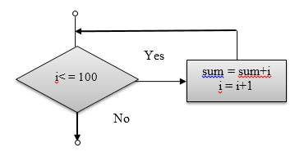
Example: Consider a program segment to find the sum of first 100 integers.
i = 1
sum = 0
while (i<= 100):
sum = sum + i
i = i + 1

Slide 80
Sentinel-Controlled Loops
In sentinel-controlled looping, the number of times the iteration is to be performed is not known beforehand.
The execution or termination of the loop depends upon a special value called the sentinel value.
If the sentinel value is true, the loop body will be executed, otherwise it will not.
Since the number of times a loop will iterate is not known in advance, this type of loop is also known as indefinite repetition loop.

Slide 81
Algorithm: To find the sum of first N integers
Start
Read N
Assign sum = 0, i = 0
Calculate i = i + 1 and sum = sum + i
Check whether i>= N, if no repeat step 4. Otherwise go to next step.
Print the value of sum
Stop

Slide 82
Recursion
Recursion is a powerful programming technique that can be used to solve the problems that can be expressed in terms of similar problems of smaller size.
For example, consider a problems to find the factorial of a number n. The problem of finding the factorial of n can be expressed in terms of a similar problem of smaller size as n! = n × (n−1)!. Recursion provides an elegant way of solving such problems.
In recursive programming, a function calls itself. A function that calls itself is known as a recursive function, and the phenomenon is known as recursion.

Slide 83
Recursion is classified according to the following criteria:
Whether the function calls itself directly (i.e. direct recursion) or indirectly (i.e. indirect recursion).
Whether there is any pending operation on return from a recursive call. If the recursive call is the last operation of a function, the recursion is known as tail recursion.
A Function is directly recursive if it calls itself, i.e. the function body contains an explicit call to itself.
Indirect recursion occurs when a function calls another function, which in turn calls another function, eventually resulting in the original function being called again.

Slide 84
Example: Recursive algorithm for finding the factorial of a number
Step 1: Start
Step 2: Read number n
Step 3: Call factorial (n)
Step 4: Print factorial f
Step 5: Stop
Factorial (n)
Step 1: if n = = 1 then return 1
Step 2: Else
f = n*factorial (n-1)
Step 3: Return f

Slide 85
Thank You

